Slide 1

Robotics
Coding
Circuit Design
Games and Apps Development
Face Detection: AI with Pictoblox
Artificial Intelligence
…Nurturing STEM Skills for the future
www.brainiacs.com.ng
Learn, Play, Innovate

Slide 2


Wow Factor
www.brainiacs.com.ng
Learn, Play, Innovate

Slide 3

Key Skills
Computational thinking
Problem Solving
Programming
www.brainiacs.com.ng
Learn, Play, Innovate
Notes:
Computational thinking
Problem solving
Collaborative skills.
Creative thinking.
Digital Communication

Slide 4
Learning Objectives
At the end of the lesson, the learners should be able to:
Describe the face detection concept
Write a program to recognize the expressions/emotion of the human face
Test the face detection application in pictoblox
www.brainiacs.com.ng
Learn, Play, Innovate

Slide 5
What will you need?
A pc/laptop with a camera.
PictoBlox 5.1 and above.
Internet connection.
A webcam.
www.brainiacs.com.ng
Learn, Play, Innovate
Notes:
Entertainment: it is extensively used for entertainment and perhaps it is the greatest use for computer graphics. Famous animation programs such as Tom and Jerry, Mickey Mouse and Donald Duck are created to make everyone laugh at the same time sharing important life lessons and moral values.
Gaming: It is an industry where everything is dependent on animation as most 3D characters for games are created with animation.
Can be used for Advertisement.

Slide 6
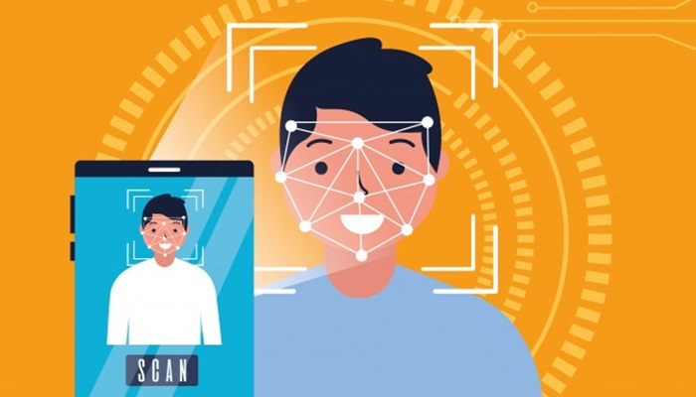
What is Face Detection?
Face detection also called facial detection is an artificial intelligence (AI) based computer technology used to find and identify human faces in digital images.
Face detection technology can be applied to various fields which includes security, biometrics, law enforcement, entertainment and personal safety to provide surveillance and tracking of people in real time.
www.brainiacs.com.ng
Learn, Play, Innovate

Slide 7
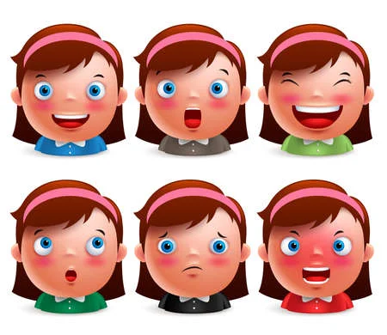
What is Face Detection?(cont)
In this project, face detection will be used to recognise the expressions of the human face such as anger, fear, disgust, happiness, sadness, surprise etc
www.brainiacs.com.ng
Learn, Play, Innovate

Slide 8
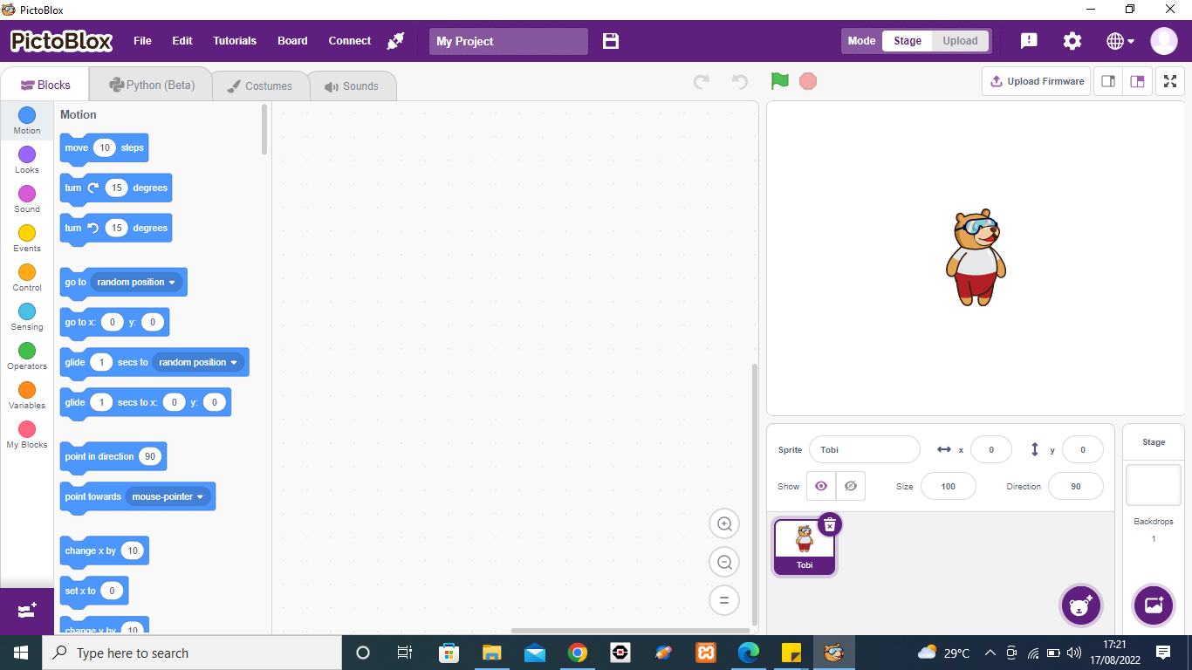
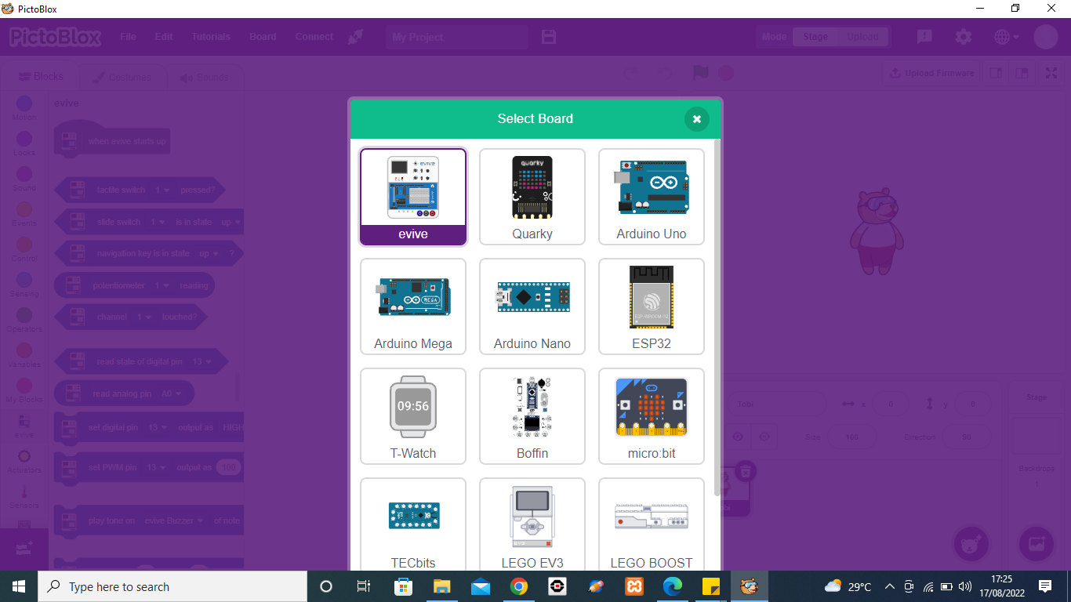
Adding Face Detection Extension
Launch pictoblox software. Add the Face Recognition extension.
(2) Select the board as evive
(1) Click Board
www.brainiacs.com.ng
Learn, Play, Innovate

Slide 9
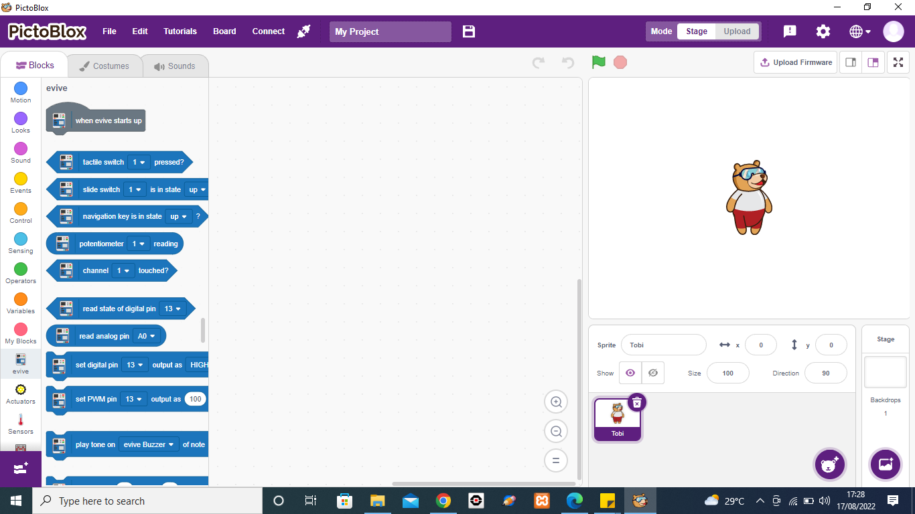
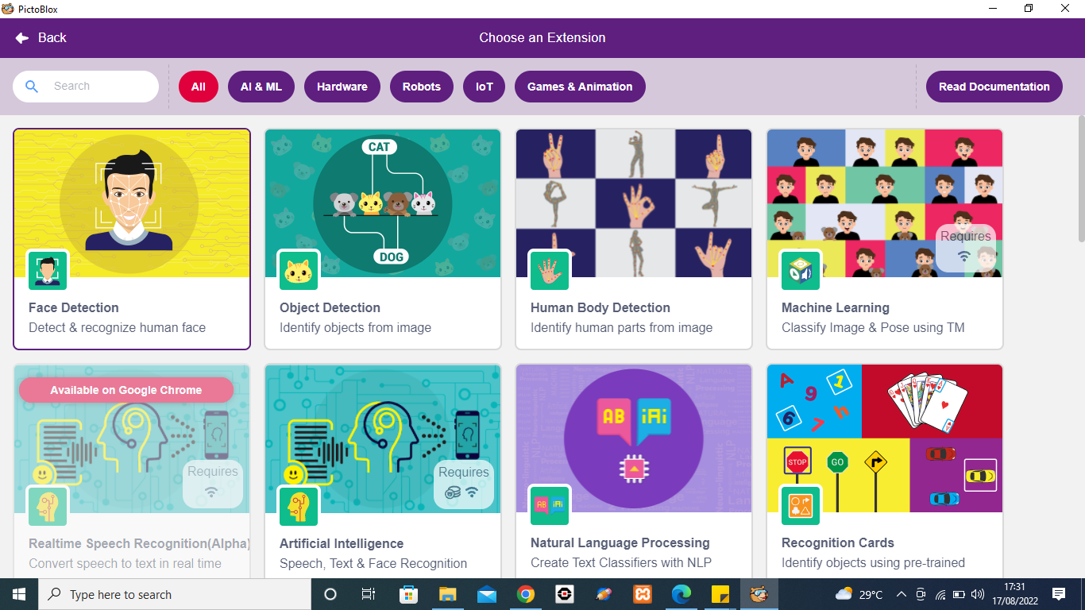
Adding Face Detection Extension(Cont)
(4) Select Face Detection
(3) Click on the Add extension button
www.brainiacs.com.ng
Learn, Play, Innovate
Notes:
Learners will notice new blocks are being added under the same extension
Please remember that this extension requires an Internet connection in order to process images. Also, wait till models get loaded it might take a few moments to load.

Slide 10
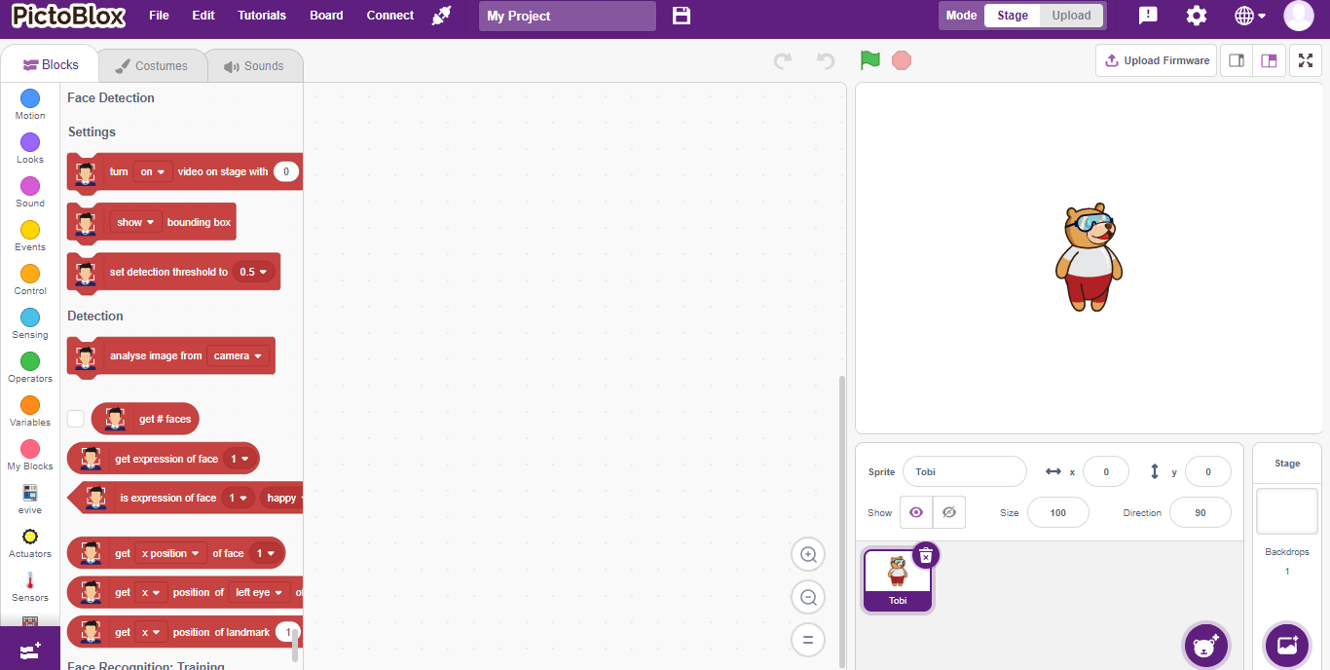
Adding sprite
Add a square box sprite to the stage
(2) Click on add sprite button to add the square box sprite
(1) Right click on it and select delete from the drop-down to delete tobi sprite.
www.brainiacs.com.ng
Learn, Play, Innovate
Notes:
Entertainment: it is extensively used for entertainment and perhaps it is the greatest use for computer graphics. Famous animation programs such as Tom and Jerry, Mickey Mouse and Donald Duck are created to make everyone laugh at the same time sharing important life lessons and moral values.
Gaming: It is an industry where everything is dependent on animation as most 3D characters for games are created with animation.
Can be used for Advertisement.

Slide 11

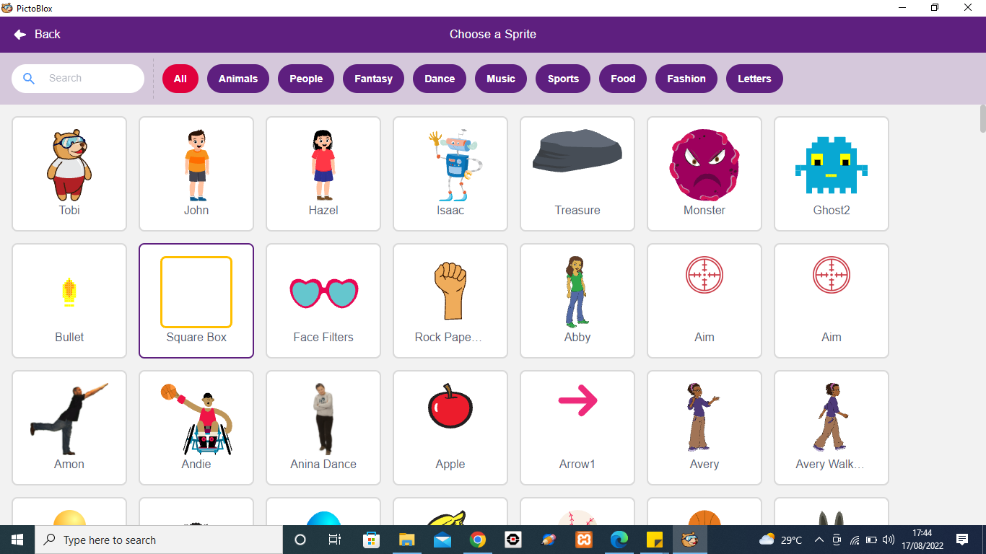
Adding sprite(cont)
(3) add the square box sprite
www.brainiacs.com.ng
Learn, Play, Innovate
Notes:
Entertainment: it is extensively used for entertainment and perhaps it is the greatest use for computer graphics. Famous animation programs such as Tom and Jerry, Mickey Mouse and Donald Duck are created to make everyone laugh at the same time sharing important life lessons and moral values.
Gaming: It is an industry where everything is dependent on animation as most 3D characters for games are created with animation.
Can be used for Advertisement.

Slide 12
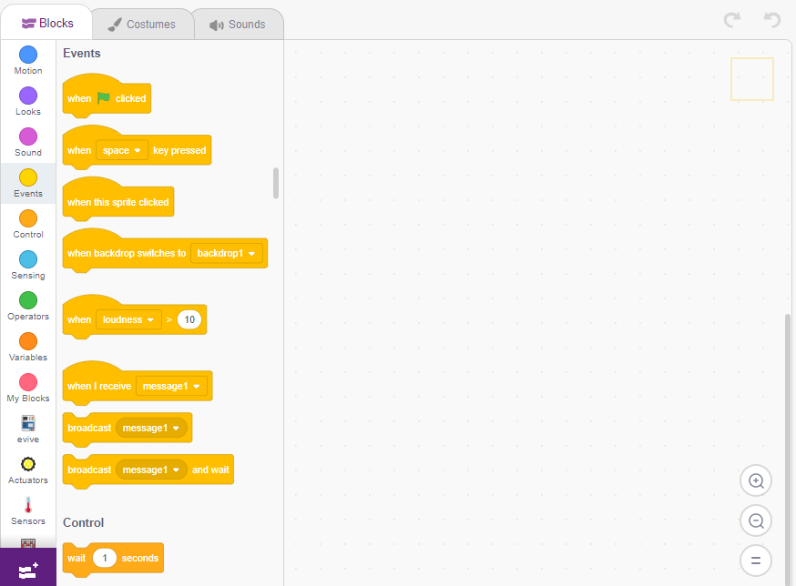
Programming to recognize the human face
Select the Square box sprite to write the script.
(1) Drag and drop the when Green flag clicked block to execute the program every time the green flag is clicked.
(2) Search for and Click the Face extension palette to turn the camera ON. Drag out the turn ON video on stage block.
www.brainiacs.com.ng
Learn, Play, Innovate
Notes:
Entertainment: it is extensively used for entertainment and perhaps it is the greatest use for computer graphics. Famous animation programs such as Tom and Jerry, Mickey Mouse and Donald Duck are created to make everyone laugh at the same time sharing important life lessons and moral values.
Gaming: It is an industry where everything is dependent on animation as most 3D characters for games are created with animation.
Can be used for Advertisement.

Slide 13
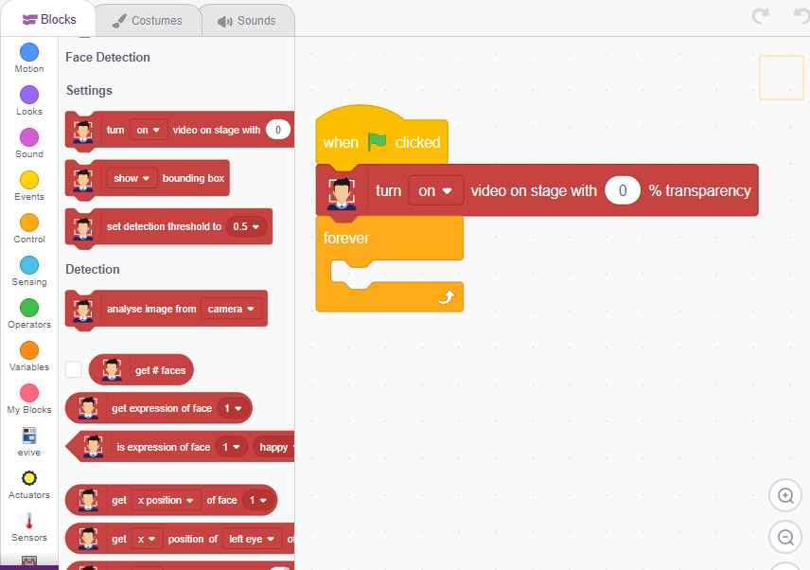
Programming to recognize the human face(Cont)
Select the Square box sprite to write the script.
(3) Click the Control palette, drag out the forever to run the script forever
www.brainiacs.com.ng
Learn, Play, Innovate
Notes:
Entertainment: it is extensively used for entertainment and perhaps it is the greatest use for computer graphics. Famous animation programs such as Tom and Jerry, Mickey Mouse and Donald Duck are created to make everyone laugh at the same time sharing important life lessons and moral values.
Gaming: It is an industry where everything is dependent on animation as most 3D characters for games are created with animation.
Can be used for Advertisement.

Slide 14
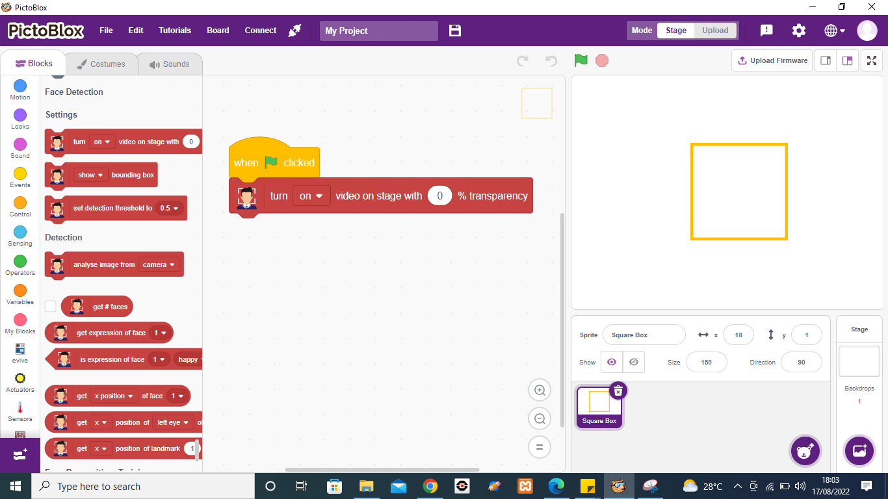
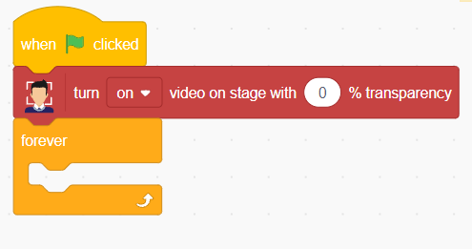
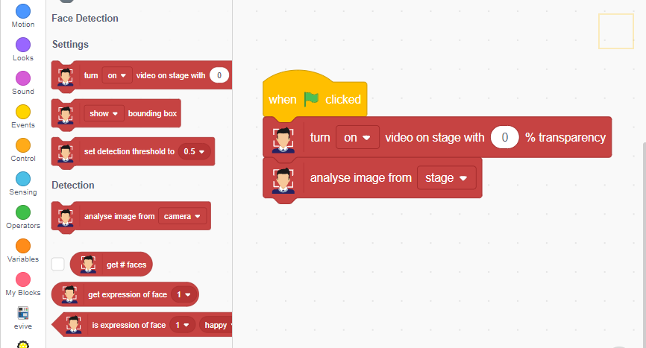
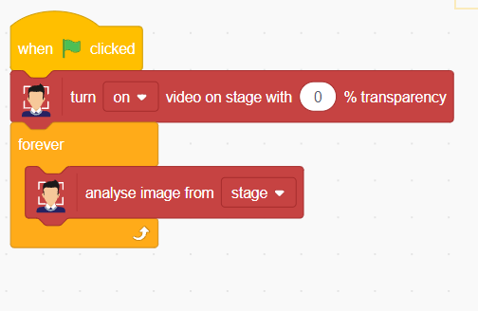
Programming to recognize the human face(Cont)
Next, we need to recognize the image. Thus, we now need to process the image projected on the stage.
(5) Choose the stage option from the drop-down
(4)Drag and use the analyse image block,
www.brainiacs.com.ng
Learn, Play, Innovate
Notes:
Entertainment: it is extensively used for entertainment and perhaps it is the greatest use for computer graphics. Famous animation programs such as Tom and Jerry, Mickey Mouse and Donald Duck are created to make everyone laugh at the same time sharing important life lessons and moral values.
Gaming: It is an industry where everything is dependent on animation as most 3D characters for games are created with animation.
Can be used for Advertisement.

Slide 15
Programming to recognize the human face(Cont)
Once the image is recognized, you can have all the data obtained from the image stored in the memory which you can use later on when and where required.
www.brainiacs.com.ng
Learn, Play, Innovate

Slide 16
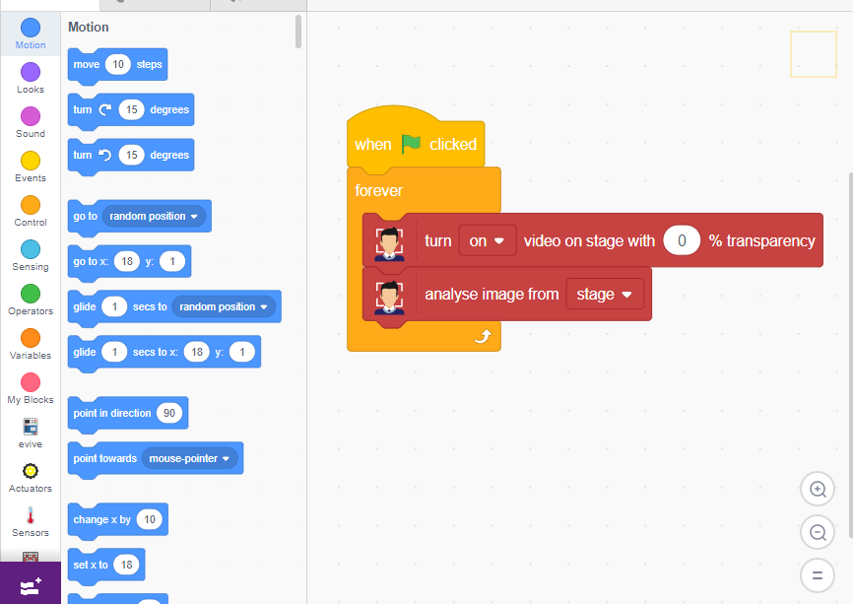
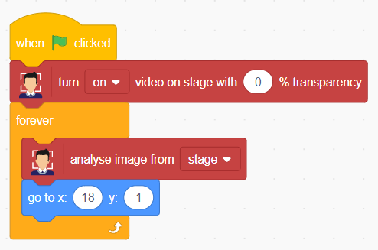
Programming to recognize the human face(Cont)
Next, we need to add an outline to be marked around the face. Thus, in order to show that the face is recognized, we will move our square box to the location of our recognized face.
(6)Click the Motion palette, drag out the go to x () and y () to make the square box location our recognized face
www.brainiacs.com.ng
Learn, Play, Innovate
Notes:
Entertainment: it is extensively used for entertainment and perhaps it is the greatest use for computer graphics. Famous animation programs such as Tom and Jerry, Mickey Mouse and Donald Duck are created to make everyone laugh at the same time sharing important life lessons and moral values.
Gaming: It is an industry where everything is dependent on animation as most 3D characters for games are created with animation.
Can be used for Advertisement.

Slide 17
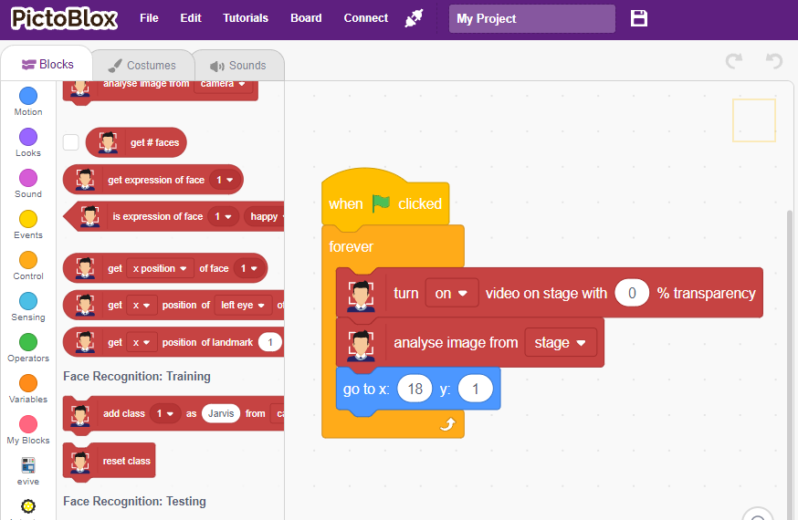
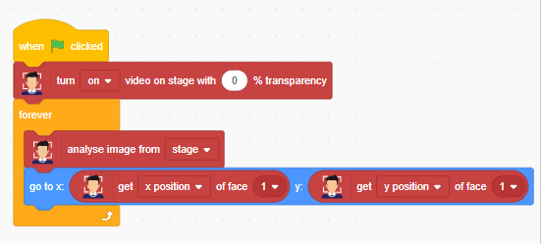
Programming to recognize the human face(Cont)
Move the box around the face, we need the X and Y position of the face.
(8)Drop each in the white spaces of the go to x () and y () block and select x-position from the first drop-down and y-position from the second drop-down.
(7)Click the Face detection palette, drag out the get () of face () which contains all the details including the size and the location of the face.
www.brainiacs.com.ng
Learn, Play, Innovate
Notes:
Entertainment: it is extensively used for entertainment and perhaps it is the greatest use for computer graphics. Famous animation programs such as Tom and Jerry, Mickey Mouse and Donald Duck are created to make everyone laugh at the same time sharing important life lessons and moral values.
Gaming: It is an industry where everything is dependent on animation as most 3D characters for games are created with animation.
Can be used for Advertisement.

Slide 18
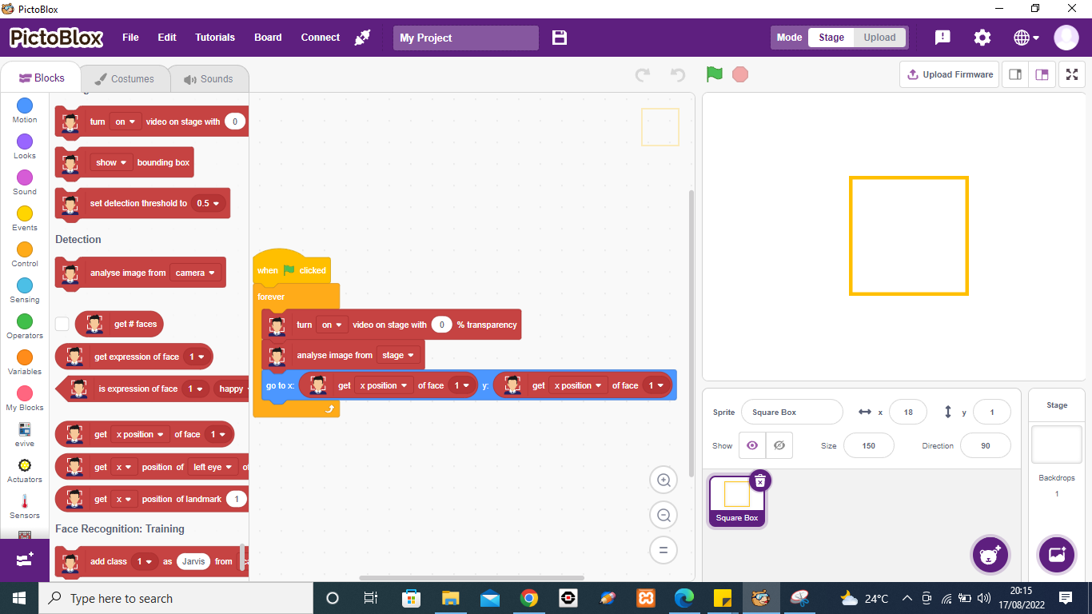
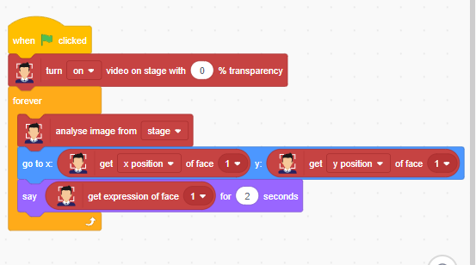
Programming to recognize the human face(Cont)
Now that the face has been recognized and its position is located, it’s now time to recognize the expression of the face.
(11)Drop get expression of face () into say block to gather the information of the face expression.
(9)Click the Looks palette, drag out the say () for () seconds block to make the square box sprite to say out the expression of the face
(10)Click the Face detection palette, drag out the get expression of face ()
www.brainiacs.com.ng
Learn, Play, Innovate
Notes:
Entertainment: it is extensively used for entertainment and perhaps it is the greatest use for computer graphics. Famous animation programs such as Tom and Jerry, Mickey Mouse and Donald Duck are created to make everyone laugh at the same time sharing important life lessons and moral values.
Gaming: It is an industry where everything is dependent on animation as most 3D characters for games are created with animation.
Can be used for Advertisement.

Slide 19
Programming to recognize the human face(Cont)
With this script, the project is ready.
www.brainiacs.com.ng
Learn, Play, Innovate
Notes:
Entertainment: it is extensively used for entertainment and perhaps it is the greatest use for computer graphics. Famous animation programs such as Tom and Jerry, Mickey Mouse and Donald Duck are created to make everyone laugh at the same time sharing important life lessons and moral values.
Gaming: It is an industry where everything is dependent on animation as most 3D characters for games are created with animation.
Can be used for Advertisement.

Slide 20
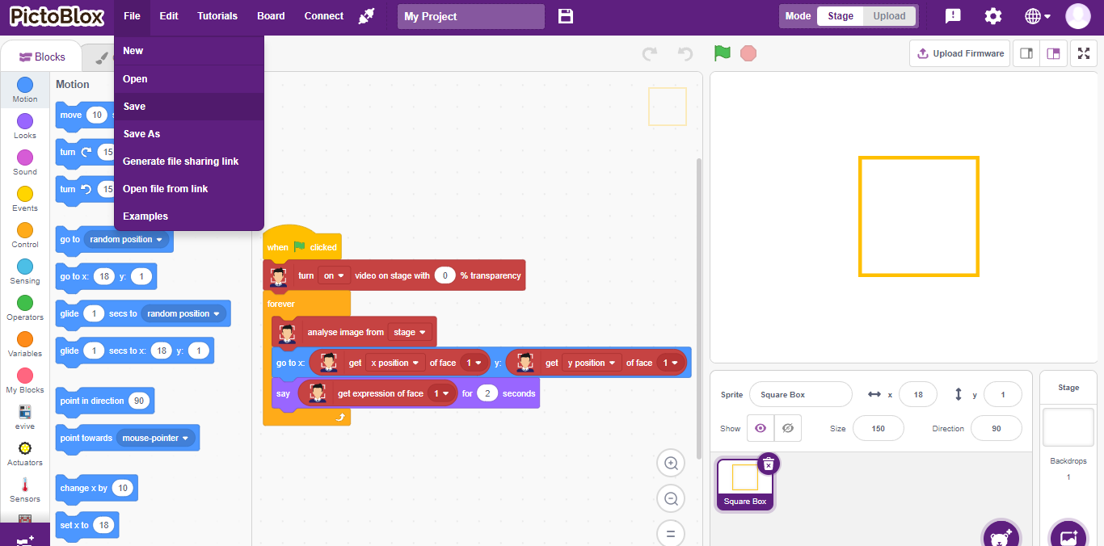
Programming to recognize the human face(Cont)
Save and test the face detection script
(2)Click on the green flag button and wait for the script to recognize and display the emotion of a person on the stage.
(1)Click file and select save
www.brainiacs.com.ng
Learn, Play, Innovate

Slide 21
Lesson Outcomes
Learners are able are able to:
Describe the face detection concept
Write a program to recognize the expressions/emotion of the human face
Test the face detection application in pictoblox
www.brainiacs.com.ng
Learn, Play, Innovate
Notes:
A Quick recap of the day’s lesson

Slide 22

Well-done!
www.brainiacs.com.ng
Learn, Play, Innovate

Slide 23
Contact Us
Phone No: +234 909 109 5057
Email: brainiacsng@gmail.com
info@brainiacs.com.ng
Website: www.brainiacs.com.ng
Google+: brainiacsng
Twitter: Brainiacs_Ng
Facebook: Brainiacs Nigeria
Youtube Channel: Brainiacs_Ng
www.brainiacs.com.ng
Learn, Play, Innovate

